Slide 1
Tech Norms
Cameras on if possible, please
Mute/Unmute
Side Conversations
Minimize Distractions
Please no screenshots etc

Slide 2
Check In
Notes:
Name (so I know how you like to pronounce it), pronouns if you’d like (reason I’m asking), and just briefly how you’re doing today – and where are you calling in from? (will help me set up groups quickly later)

Slide 3
Implicit Bias and Mindfulness
Implicit bias is…
Part of how our brains work
But also… where did these particular ideas come from?
What can we do
Recognize – “It could be me!”
Individuation vs. categorization
Put ourselves in others’ shoes
Detect, reflect, reject
Automaticity vs. mindfulness

Slide 4
Mindfulness Moment
Centering

Slide 6
APH Equity Academy Core Outcomes: Summary
Develop shared framework and vocabulary for understanding and discussing how racist inequities persist even in the absence of explicit, intentional discrimination
Systemic Racism – Institutional, Structural, Historic
Implicit Bias, Microaggressions
Intersectionality
Identify how this happens in our work in public health
Generate, learn, practice, and normalize the use of tools/strategies for doing something about it
Notes:
Expanded from REDI Plan
Based on recommendations from GARE (Government Alliance on Race and Equity) Resource Guide, Page 13 and
GARE Racial Equity Toolkit: “Training is not just to cultivate skills for individual employees, but is also to build the skill of teams to create support for group implementation and to create a learning culture.”
Sources:
https://www.racialequityalliance.org/wp-content/uploads/2015/02/GARE-Resource_Guide.pdf
https://www.racialequityalliance.org/wp-content/uploads/2015/10/GARE-Racial_Equity_Toolkit.pdf

Slide 7
APH Equity Academy Core Courses
COURSE 1
Race and Racism
COURSE 2
Intersectionality, Implicit Bias, and Microaggressions
COURSE 3
Health Equity
E-Learning Content and Classroom Sessions
Notes:
Course 1 – e-Learning dealt with race and racism, and classroom session also explored those topics using a game as a metaphor
Course 2 – e-Learning focusing on Intersectionality, with particular focus on LGBTQIA+ health equity, and implicit bias; classroom session focuses on microaggressions

Slide 8
Guiding Questions for Today
What are microaggressions?
Why do they matter?
How can we respond?

Slide 9
Format for Today (break half-way)
Whole Group Intro and Discussion
Sample Microaggression Scenarios
Small Group Discussion
Share Back
1-3 times
Whole Group Closing

Slide 10
Proposed Group Agreements
Adapted from Beyond Diversity, Courageous Conversations:
Stay Engaged
Experience Discomfort
Tell the Truth
Expect/Accept Non-Closure
And to these we add:
Stories Stay, Learning Leaves (confidentiality)
Please speak to best intentions when we hold one another accountable for our impact
What else do you need?
Notes:
Please do speak the truth of your experience – please also take care to tell the truth and respect the truth of the historical record, current day disparities and inequities

Slide 11
Tools to Help us Honor the Group Agreements
Stay centered enough to think and feel at the same time
Breathe
Get water, snacks, take bathroom breaks when you need to
Notice where you might be tense and try to relax, maybe try putting your hand there
In moments of big feelings, ask yourself:
What am I feeling?
What is that about?
How does that affect my work?
(adapted from Sharon Bridgforth, the Austin Project)

Slide 12
Another tool: Is this grief?
When asking yourself, “What is this about?” it may be helpful to remember the “stages” of grief:
Denial
Guilt
Anger
Bargaining
Depression, loneliness, and reflection
Reconstruction, “working through”
Acceptance
Notes:
Sometimes people hear all these agreements and tools and then think “wow – I better get ready, this is going to be a really emotional training!” And actually I haven’t designed in such a way that I’m trying to make things super intense or emotional; I try to strike a balance between telling the truth about these issues in a clear and compelling way while also not making it so upsetting – or sometimes people use the word triggering – particularly for people who live with the harmful impacts of these issues everyday already. I often use games as metaphors, or fictionalized scenarios – scenarios that are kind of cringe-y but hopefully nothing terribly traumatic, and if I do ask you to do personal reflection it’s private, and if I ask for you to share something personal it’s usually pretty limited. So I hope if I’ve done a pretty ok job of striking that balance between honesty and not going deep into really painful details, then we won’t even need many of these tools, and following the agreements feels fairly easy; but I don’t know you or what experiences you bring with me, and I can never really know what you might find upsetting, so we have these agreements and tools here as basically a safety net. And if we don’t need them in these trainings, maybe it’s still helpful to carry them with you and try them out in future conversations on these topics.

Slide 13
Chat Waterfall

Slide 14
Game
Notes:
In-person: heads up
Virtual: group counting
(do folks’ microphones work?)

Slide 15
What is a microaggression?

Slide 16
What is a microaggression?
The psychiatrist Dr. Chester M. Pierce first coined the term in the 1970s to describe subtle insults and put-downs that African Americans experience regularly.
Psychologists have since expanded its use to include this behavior toward any marginalized group.

Slide 17
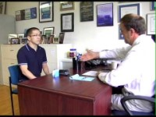
Notes:
First minute or so?

Slide 18
Why do microaggressions matter?
Why is it important to prevent and/or respond to microaggressions?

Slide 19
Microaggressions normalize oppression, and weave it into the fabric of everyday life.
Ijeoma Oluo, “So You Want to Talk About Race”

Slide 20
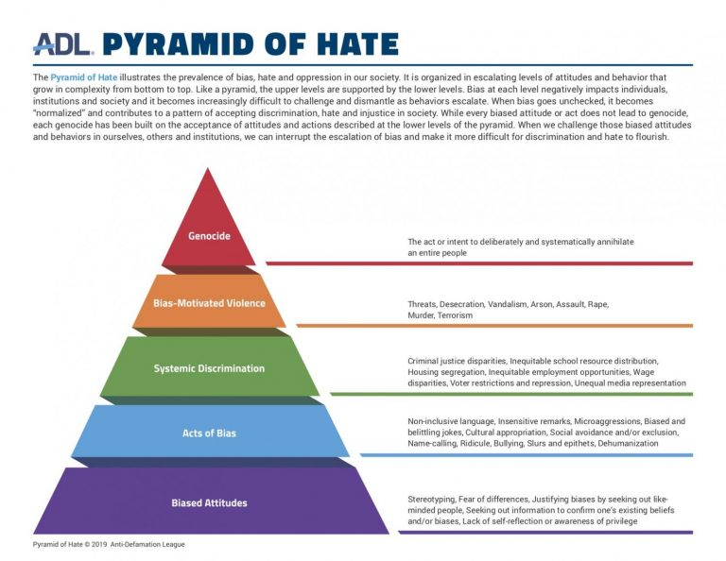

Slide 21
System-Wide Transformation
Institutional Policies
Group Practices
Individual Actions
Individual Attitudes
Pyramid of Love? (Of Justice? Of Solidarity? Of Liberation? Of Utopia???)

Slide 22
Microaggressions and Medicine

Slide 23
Small Groups: Round 1
Tips? Also – apologies!

Slide 24
Share Back

Slide 25
Types of Microaggressions
Micro-assaults
Micro-insults
Microinvalidations
Notes:
Also from Dr. Sue

Slide 26
Small Groups: Round 2
Goals, Tips

Slide 27
Share Back

Slide 28
Practice!
Time permitting

Slide 29
Closing
Notes:
Evaluation form: https://forms.office.com/g/6kAuRqm6TY

