Slide 1
No Teacher Left Behind: Legal Issues Related to Teacher Shortages
JUAN J. CRUZ, J. CRUZ & ASSOCIATES LLC
JEFF CROWNOVER, DEPUTY SUPERINTENDENT FOR ACADEMICS & SCHOOL LEADERSHIP, PROSPER ISD
Notes:
Juan introduces himself and the session, then Jeff introduces himself

Slide 2
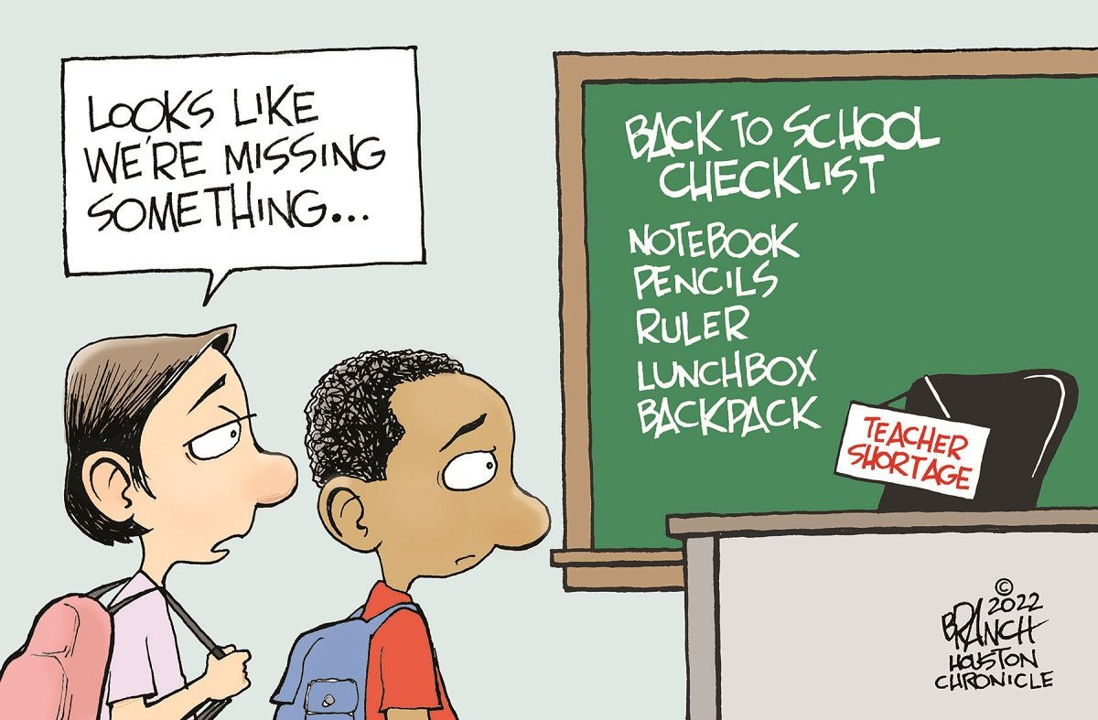
Do we have a teacher shortage?
Notes:
Jeff

Slide 3
Teachers Considering
Leaving the Profession
The percentage of Texas teachers seriously considering leaving the profession reaches highest level in three years.
2022 Charles Butt Foundation Teacher Poll

Slide 4
Texas Teachers Feel Less Valued
2020
2022
Other Teachers
Feeling valued is strongly associated with a sense of belonging at one’s school.
Feeling less valued impacts teacher morale.
School Administrators
Parents
Community
Elected Officials
2022 Charles Butt Foundation Teacher Poll
Statewide Survey by the Charles Butt Foundation
Notes:
Significant drop from 2020 to 2022
For teachers, feeling less valued is strongly associated with a sense of belonging at one’s school and the people they serve.
Working professionals need to feel a sense of purpose in their life, a shared purpose in the organization, and aligned purpose in collaboration with others.
Our goal in Prosper ISD is to maintain the culture of support, care, and treating our employees like the educated professionals they truly are.

Slide 5
Where are the Education Majors?
Percent of Incoming College Freshmen Likely to Select Education as a Chosen Field of Study
Lowest
Point in
45
Years
Notes:
The number of students who say they will major in education has reached its lowest point in 45 years.

Slide 6
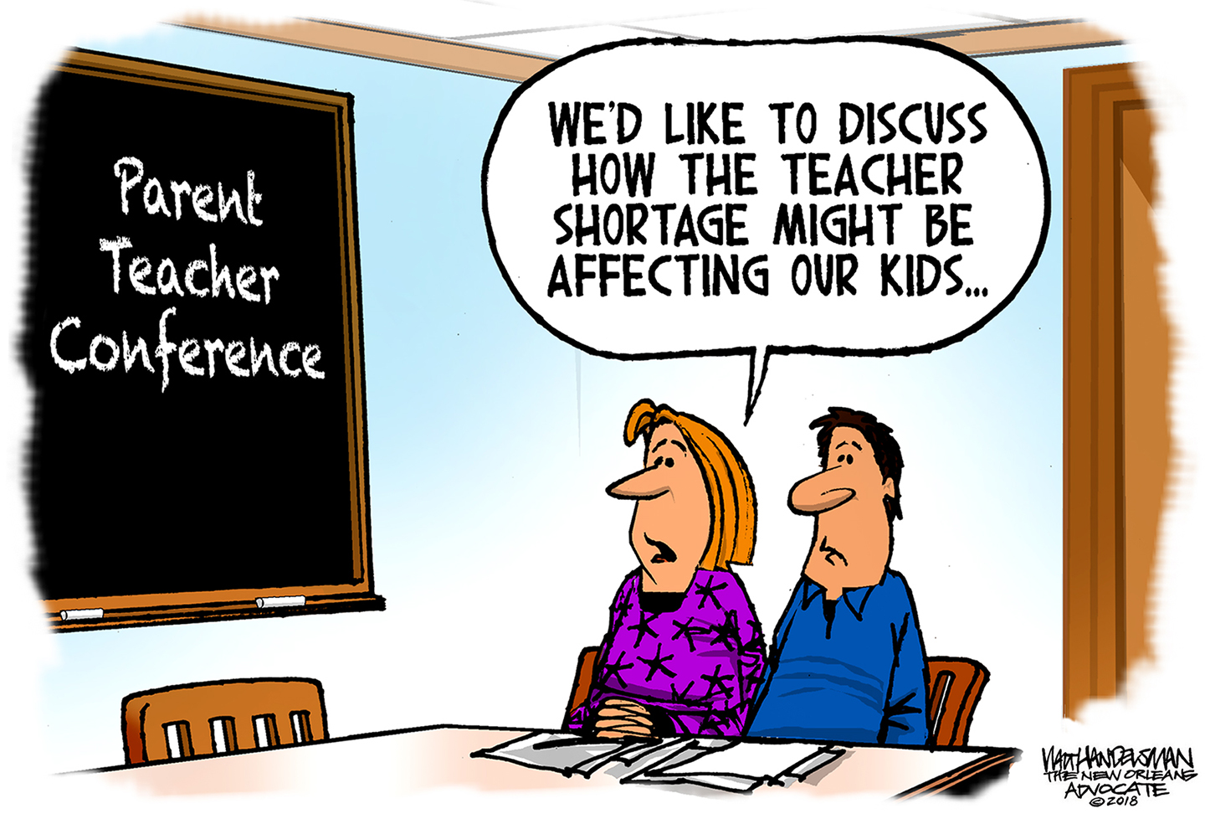
Why do we have a teacher shortage?
Notes:
Jeff

Slide 7
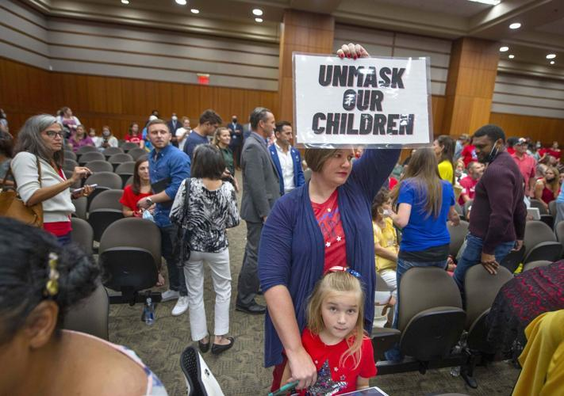
Anti-Mask Mandates
Notes:
Jeff

Slide 8
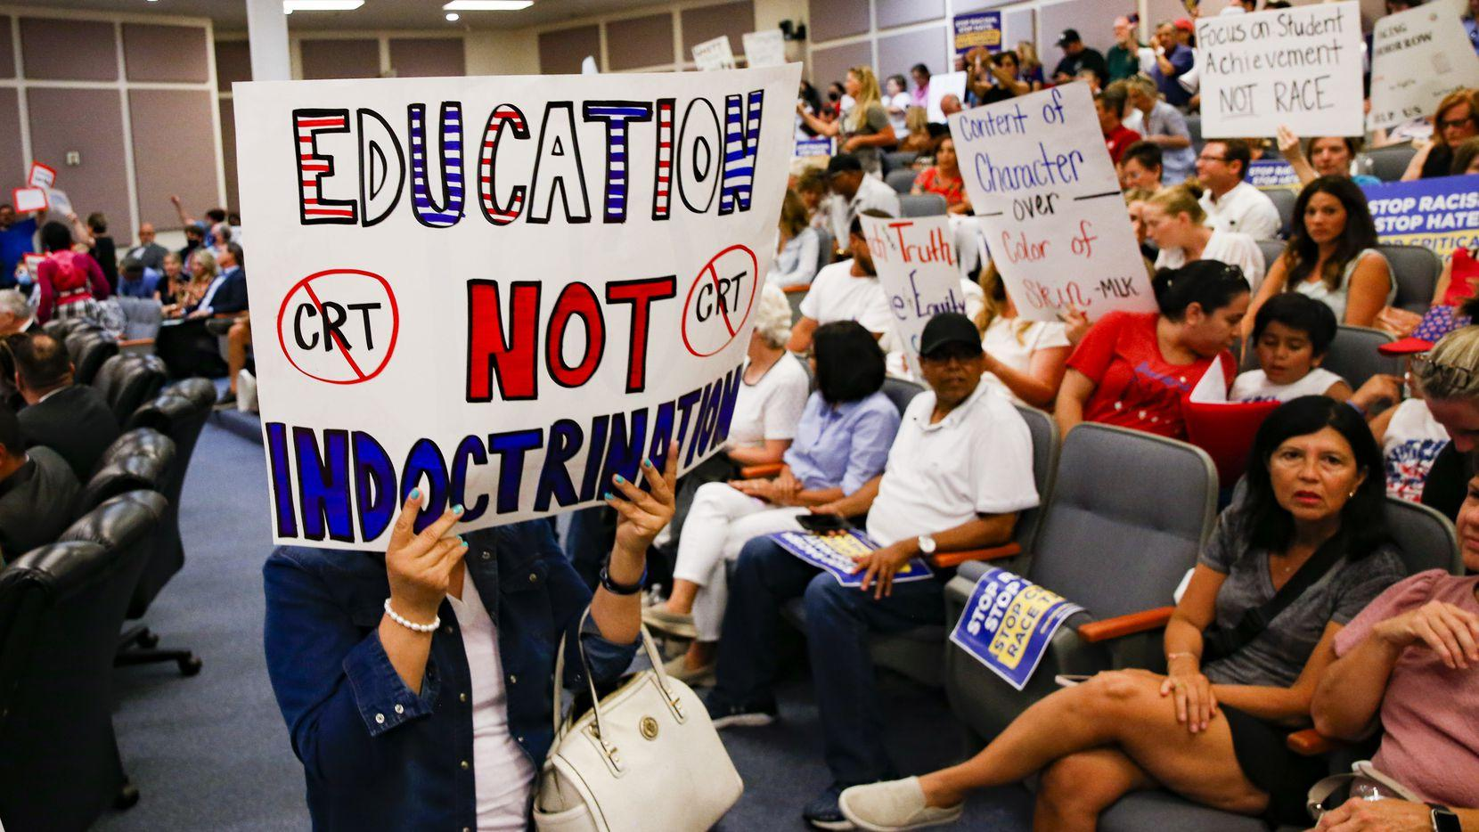
Critical Race Theory
Notes:
Jeff

Slide 9
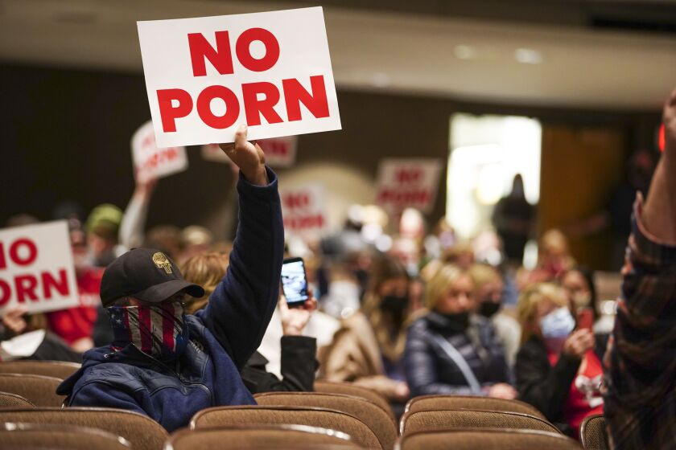
Inappropriate Books in Libraries
Notes:
Jeff

Slide 10
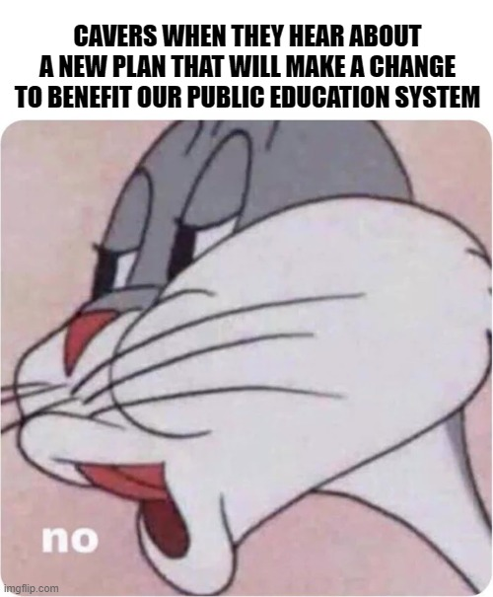
CAVERS
Citizens
Against
Virtually
Everything

Slide 11
Unruly Parents
Unreasonable grievances and complaints from parents
Texas Education Code § 37.105
A school administrator, school resource officer, or school district peace officer of a school district may refuse to allow a person to enter on or may eject a person from property under the districts control if the person refuses to leave peaceably on request and:
The person poses a substantial risk of harm to any person; or
The person behaves in a manner that is inappropriate for a school setting and:
The administrator, resource officer, or peace officer issues a verbal warning to the person that the person’s behavior is inappropriate and may result in the person’s refusal of entry or ejection; and
The person persists in that behavior.
Notes:
Juan

Slide 12
Texas Education Code § 37.105
Each school district shall maintain a record of each verbal warning issued, including:
The name of the person to whom the warning was issued and the date of issuance.
The district shall provide to the person written information explaining the appeal process at the time the person is refused entry to or ejected from a school district’s property under this section.
The term of a person’s refusal of entry to or ejection from a school district’s property under this section may not exceed two years.
A school district shall post on the district’s internet website and each district campus shall post on any internet website of the campus a notice regarding the provisions of this section, including the appeal process.

Slide 13
So, what are people doing to try to fix these “problems”?
Notes:
Jeff

Slide 14
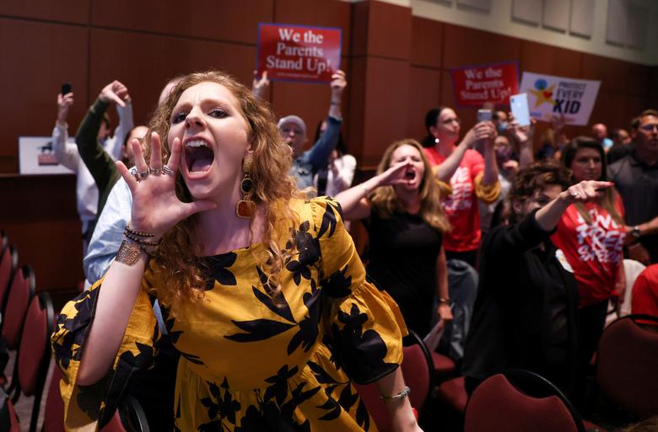
Show up and yell at school board meetings
Notes:
Jeff

Slide 15
Post on Social Media
Notes:
Jeff

Slide 16
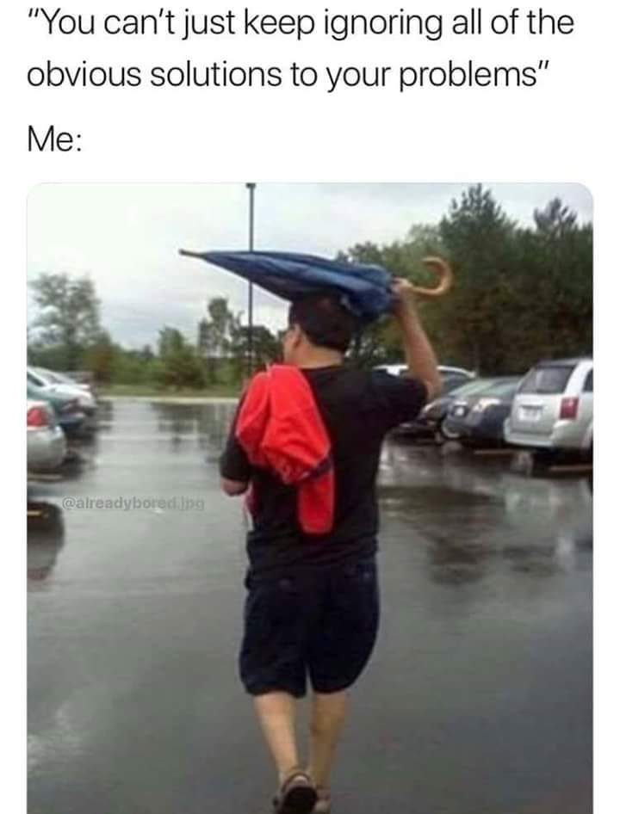
And that’s basically it.
Notes:
Jeff

Slide 17
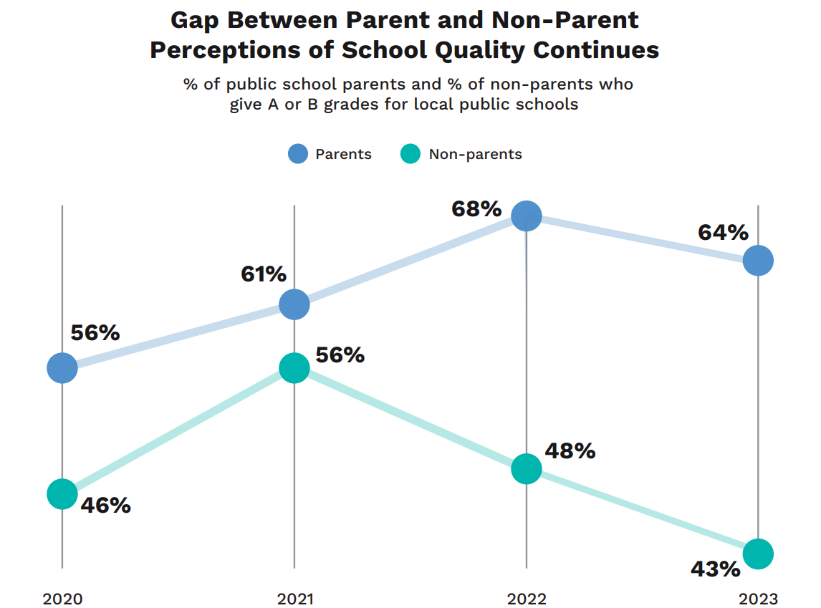
Charles Butt Foundation 2023 Poll on Texans’ Attitudes Toward Public Education
Notes:
Jeff

Slide 18
Charles Butt Foundation 2023 Poll on Texans’ Attitudes Toward Public Education
Notes:
Jeff

Slide 19
Our politicians have helped lower the temperature, right?

Slide 20
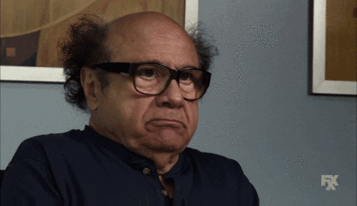

Slide 21
On the contrary…
Notes:
Jeff

Slide 22
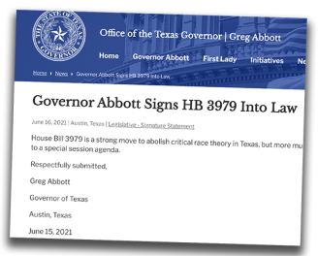
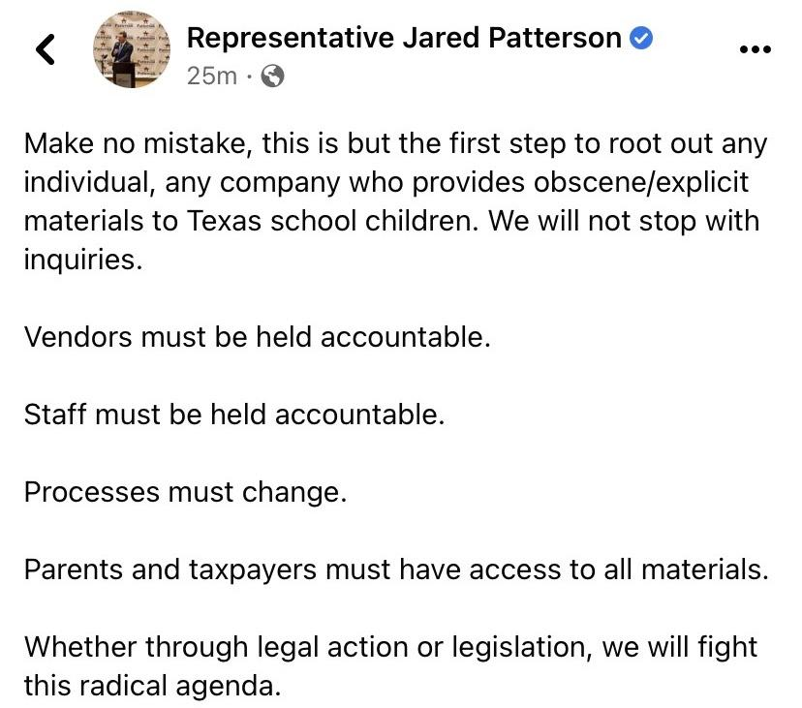
Notes:
Jeff

Slide 23
Notes:
Jeff

Slide 24
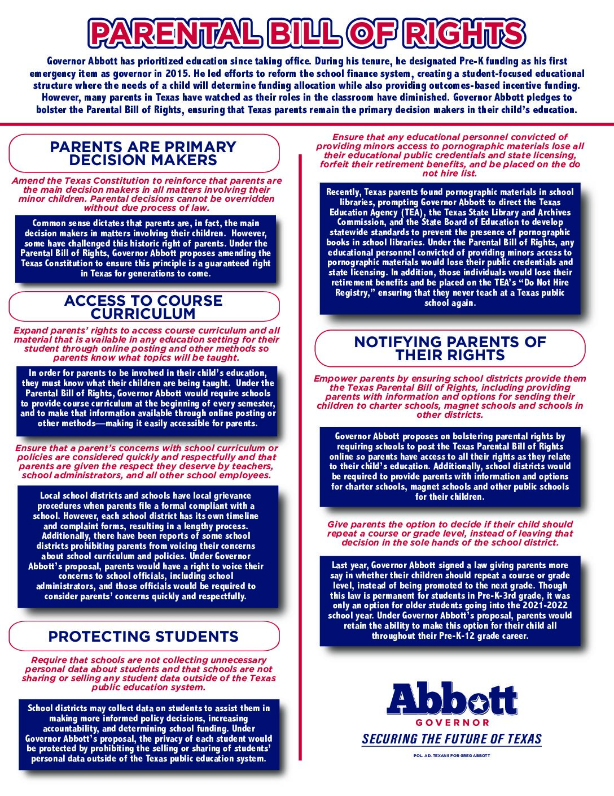
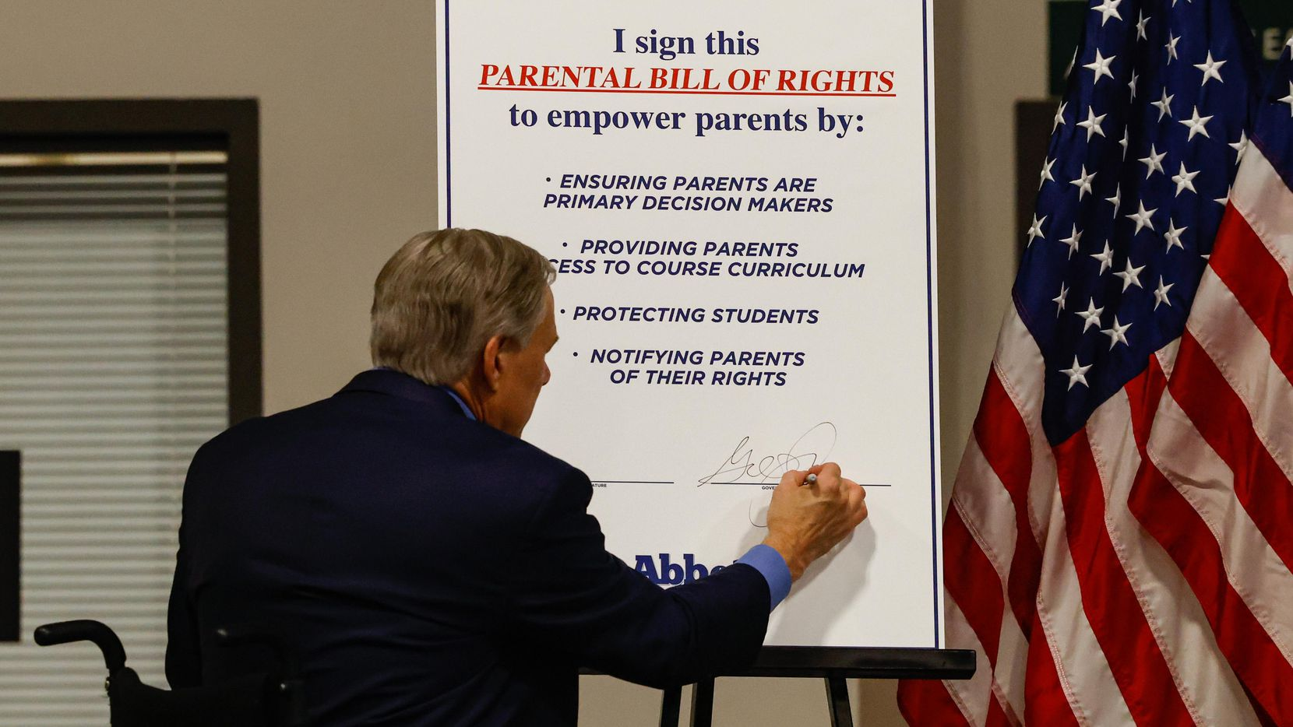
Notes:
Jeff

Slide 25
Vouchers
Notes:
Jeff

Slide 26
Wedge Issues
Pro-Children v. Anti-Children
Pro-Parent v. Anti-Parent
Teachers v. Administrators
Good v. Evil
Notes:
Jeff

Slide 27
What legal issues has all of this caused?

Slide 28
Penalty-Free Resignation Date
An educator on a Chapter 21 contract (Probationary, Continuing, Term) may resign between school years without penalty if the employee files a written resignation with the board or the board’s designee no later than the 45th day before the first day of instruction the following year.
Remember the Penalty-Free Resignation Date is unique to a school district because it is based on the individual district’s first day of instruction.
School districts also use the Penalty-Free Resignation Date for notifications of changes lowering an employee’s pay or impacting days of service.
Notice of such changes should be in writing form an official with authority, such as the superintendent or HR director, and specific enough for the employee to understand the impact of the change.
TEC § 21.105 (Probationary)
TEC § 21.160 (Continuing)
TEC § 21.210 (Term)
Dooley, Karen. “No Change to the Penalty-Free Resignation Date.” Human Resource Exchange, 4 Apr. 2022, www.tasb.org/services/hr-services/hrx/hr-laws/no-change-to-the-penalty-free-resignation-date.aspx.
Notes:
Juan

Slide 29
Penalty-Free Resignation Date & HB 2519
HB 2519 is the most extensive in the certification and licensing series consisting of several components, including teacher notification of certificate or permit suspension and resignations not following statutory process.
HB 2519 requires school districts to promptly notify teachers on probationary, term, or continuing contract of an SBEC complaint filed because the teacher resigned and failed, without good cause, to comply with statutory process to resign.
The notice must state the basis of the complaint, how the teacher may contact SBEC, and a reminder for the teacher to verify that SBEC has the teacher’s current address.
HB 2519 maintains the penalty free resignation period of 45 days before the first day of instruction; however, SBEC is prohibited from suspending or revoking a teacher’s certification as a sanction if the teacher resigns at the end of a school year and gives notice to the board or designee at least 30 days before the first day of instruction.
Dooley, Karen. “Legislative Update: Certification and Licensing.” Human Resource Exchange, 24 June 2021, www.tasb.org/services/hr-services/hrx/hr-laws/legislative-update-certification-and-licensing.aspx.
Notes:
Juan

Slide 30
Penalty-Free Resignation Date – SBEC Sanctions
The State Board of Educator Certification (SBEC) may take the following disciplinary actions against an educator’s certification:
Place restrictions on the issuance, renewal, or holding of a certificate, either indefinitely, or for a set term;
Issue an inscribed or non-inscribed reprimand;
Suspend a certificate for a set term or issue a probated suspension for a set term;
Revoke or cancel, which includes accepting the surrender of, a certificate without opportunity for reapplication for a set term or permanently; or
Impose any additional conditions or restrictions upon a certificate as deemed necessary by the SBEC.
“Disciplinary Actions Taken Against Texas Educators.” Texas Education Agency, 17 Apr. 2023, tea.texas.gov/texas-educators/investigations/disciplinary-actions-taken-against-texas-educators.
Notes:
Juan

Slide 31
Class Size Limits
TEC § 25.112 states that a school district may not enroll more than 22 students in a prekindergarten, kindergarten, first, second, third, or fourth grade class.
Class size limits do not apply to physical education or fine art classes.
If necessary, a school district must request a class size exception if:
a class size exceeds this limit not later than October 1st ; or
The 30th day after the first school day the district exceeds the limit.
The school district may forgo the request for exception in:
Any 12-week period selected by the district with a significant percentage of migratory children; or
The last twelve weeks of the school year.
This is only allowable for one 12-week period per school year.
Dooley, Karen. “Prekindergarten Added to Class Size Limits.” Human Resource Exchange, 3 Sept. 2021, www.tasb.org/services/hr-services/hrx/other-hr/prekindergarten-added-to-class-size-limits.aspx.
Notes:
Juan

Slide 32
Exceptions to Class Size Limits
The school district must notify the commissioner of education in writing noting the requested exemption period. Waivers must be granted by commissioner.
The commissioner may grant an exception to the school district from the class size limit if it creates an undue hardship on the district.
Considerations are given for:
Unanticipated enrollment growth;
Lack of facilities;
Lack of teachers; or
Financial hardships.
All granted exceptions expire at the end of the school year.
Dooley, Karen. “Prekindergarten Added to Class Size Limits.” Human Resource Exchange, 3 Sept. 2021, www.tasb.org/services/hr-services/hrx/other-hr/prekindergarten-added-to-class-size-limits.aspx.

Slide 33
Exceptions to Class Size Limits: Parent Notification
The school district is required to provide written notice of the exception to the parent or guardian of each student affected by the exception. Text of the notice must be bolded or underlined and do the following:
Specify the class for which an exception form the limit was granted;
State the number of children in the class for which the exception was granted; and
Be included in a regular mailing or other communication form the campus or district, such as information sent home with students.
The notice must be provided not later than:
The 31st day after the first day of the school year; or
The date the exception is granted if it is granted after the beginning of the school year.
Dooley, Karen. “Prekindergarten Added to Class Size Limits.” Human Resource Exchange, 3 Sept. 2021, www.tasb.org/services/hr-services/hrx/other-hr/prekindergarten-added-to-class-size-limits.aspx.

Slide 34
Exceptions to Class Size Limits: Impact on Teachers
Dealing with large classes constitutes a real challenge to every teacher: diversity of students, lack of flexibility, class climate management, difficulty of setting and enforcing classroom behavior (crowd control), minimum attention to students, limited monitoring of students’ learning and difficulty in engaging students to activities.
For every student added to a classroom, the teacher’s ability to meet the needs of students becomes increasingly more difficult.
Among the various reasons that were cited as to why teachers left either their schools or the profession, 55% of those cited were due to dissatisfaction with accountability pressures and teaching conditions (10% specifically alluded to larger class sizes).
Fortes, Pauline & Tchantchane, Abdellatif. (2010). Dealing with Large Classes: A Real Challenge. Procedia - Social and Behavioral Sciences. 8. 272-280. 10.1016/j.sbspro.2010.12.037.
Carver-Thomas, D. & Darling-Hammond, L. (2017). Teacher turnover: Why it matters and what we can do about it (brief). Palo Alto, CA: Learning Policy Institute.

Slide 35
“Good Cause” for Termination
Probationary and Continuing Contracts: “Good cause” is the employee’s failure to meet the accepted standards of conduct for the profession as generally recognized and applied in similarly-situated Texas school districts. Tex. Educ. Code §§ 21.104(a), .156(a)
Term Contracts: The Texas Education Code does not provide a definition of good cause for the purposes of term contract terminations. Instead, the statute refers to “good cause as determined by the board.” Tex. Educ. Code § 21.211(a).
Texas courts have applied the following definition for good cause to terminate a term contract:
“. . . the employee’s failure to perform the duties in the scope of employment that a person of ordinary prudence would have done under the same or similar circumstances. An employee's act constitutes good cause for discharge if it is inconsistent with the continued existence of the employer-employee relationship.” Lee–Wright, Inc. v. Hall, 840 S.W.2d 572, 580 (Tex. App.—Houston [1st Dist.] 1992, no writ).
Ball, Joe. “Employment Terminations: Tips for Getting It Right.” Texas Association of School Boards, www.tasb.org/services/board-development-services/events/governance-camp/documents-and-images.aspx. Accessed 27 June 2023.
Notes:
Juan

Slide 36
“Good Cause” for Termination (Cont’d.)
Are boards’ determinations of what is good cause changing?
Is a good cause finding more difficult given our current teacher shortage/political situation?

Slide 37
Special Education Issues
Since 2013, Texas has seen a continuous growth in the number of special education students.
37.9% growth from 2013-2021.
Special Education teachers have been reported to be particularly vulnerable to burnout.
Research shows that the significant variables associated with special education teacher burnout rates were low levels of self-efficacy in teachers due to heightened stress levels and emotional exhaustion – Special Education can be very unforgiving.
Without the proper support, teachers are having to work through their planning time and lunch time – overworked teachers risk not being able to meet the services and needs of the student’s IEP.
“It creates this emotional dissonance because it’s very anxiety-provoking to know that I’m supposed to be covering all of these services, but I don’t have the staff or the supplies or the space to do it. So, therefore, I’m out of compliance, and it’s not really my fault,” said Special Education Teacher, Elisabeth Meyer.
“Texas Public School Finance Overview.” Texas Education Agency, Mar. 2022.
Ybarra, Gabriella. “As Teacher Vacancies Mount, Special Education Teachers Struggle to Meet Student Needs.” Reporting Texas, 11 Dec. 2022, www.reportingtexas.com/as-teacher-vacancies-mount-special-education-teachers-struggle-to-meet-student-needs/.
Notes:
Juan

Slide 38
So, what can we do about this?

Slide 39
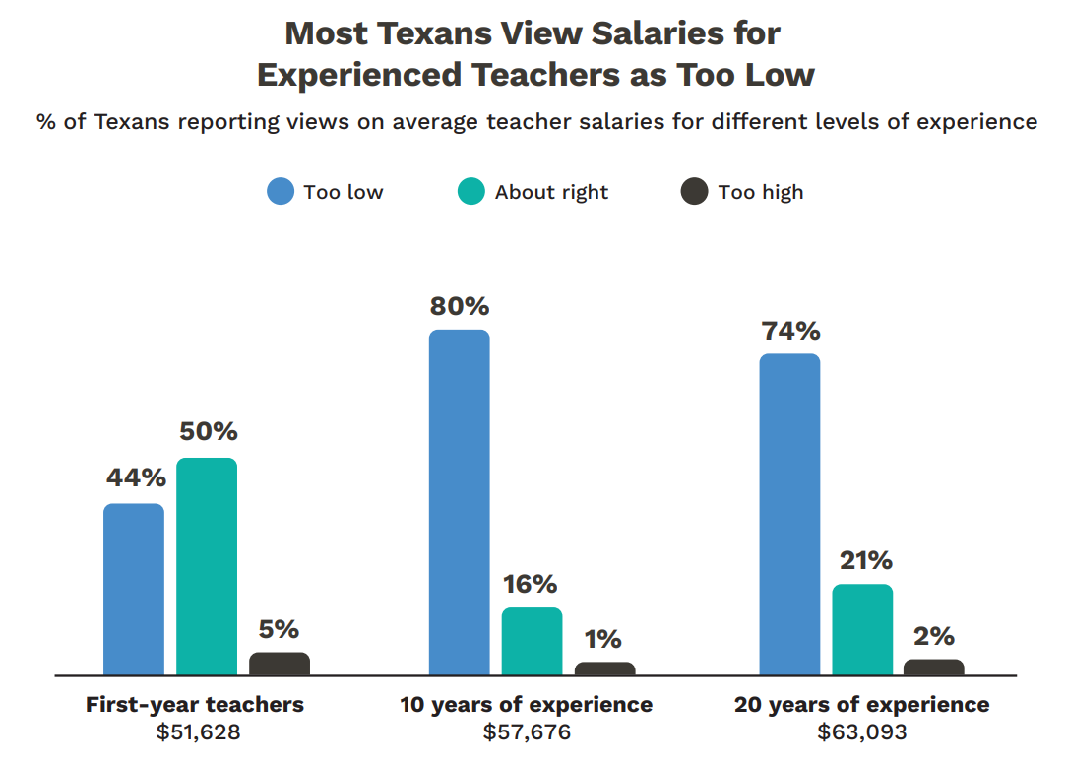
Compensation
Charles Butt Foundation 2023 Poll on Texans’ Attitudes Toward Public Education
Notes:
Jeff

Slide 40
Law and Policy Impacts on Teacher Attrition in Public Education: Data Suggesting a New Focus Beyond the Silver Bullets of Targeted STEM and Other Salary Increases
Hanks, Joseph; Ferrin, Scott E.; Davies, Randall S.; Christensen, Steven S.; Harris, Scott P.; and Bowles, W. Bryan (2020) "Law and Policy Impacts on Teacher Attrition in Public Education: Data Suggesting a New Focus Beyond the Silver Bullets of Targeted STEM and Other Salary Increases," BYU Education & Law Journal: Vol. 2020 : Iss. 2 , Article 3. Available at: https://scholarsarchive.byu.edu/byu_elj/vol2020/iss2/3
Notes:
Jeff

Slide 41
Not in Texas, right?
“It is difficult to know what research base policymakers and legislators draw upon to address education-policy decisions. Many current policies are not promising nor effective in addressing teacher shortages and retention, and many researchers assert that these policies are not supported by research.”
Notes:
Jeff

Slide 42
More Than Compensation
Most current legislative and policy efforts to combat teacher shortages in public schools in the U.S. focus on raising teacher salaries, or on incentivizing certain key subject matters in the sciences and math, known as Science, Technology and Math (STEM) initiatives.
The ostensible purpose of these legislative and policy efforts is to increase induction and subsequent retention of highly qualified teachers who will then impact educational attainment of students.
The major tool used has been salary incentives for new teachers or salary augmentation for existing teachers in certain subject matters.
Notes:
Jeff

Slide 43
More Than Compensation
A statewide survey of teachers in one western state suggests that current legal and policy approaches may be ineffective because they do not affect the actual factors that impact teacher induction and retention.
Factors that were highly predictive of teachers' satisfaction with their current position included (a) reasonable expectations of teachers and (b) well-behaved students; while somewhat predictive factors were (a) a trusting and supportive environment, (b) school administration’s vision for improving learning, (c) professional development opportunities, and (d) data analysis support.
Notes:
Jeff

Slide 44
More Than Compensation
As a matter of education policy and law, these data suggest that the current emphasis on increasing teacher pay may have some positive impact on the desired goal of recruitment and retention, but the power of most current policy initiatives is low in comparison to other factors cited by research subjects.
The authors conclude that to be successful in teacher retention and recruitment new policy and initiatives must not focus on salary incentives alone, but turn to the more powerful factors cited by these educators, such as improving teachers’ satisfaction with their teaching position by improving teachers’ work conditions.
Notes:
Jeff

Slide 45
Make Educators Feel Valued
Ask educators what they want/need and listen to them.
Treat educators like professionals they are.
Get creative with incentives other than compensation.
Take a good look at compliance tasks versus what truly makes an impact on kids.
Notes:
Juan/Jeff

Slide 46
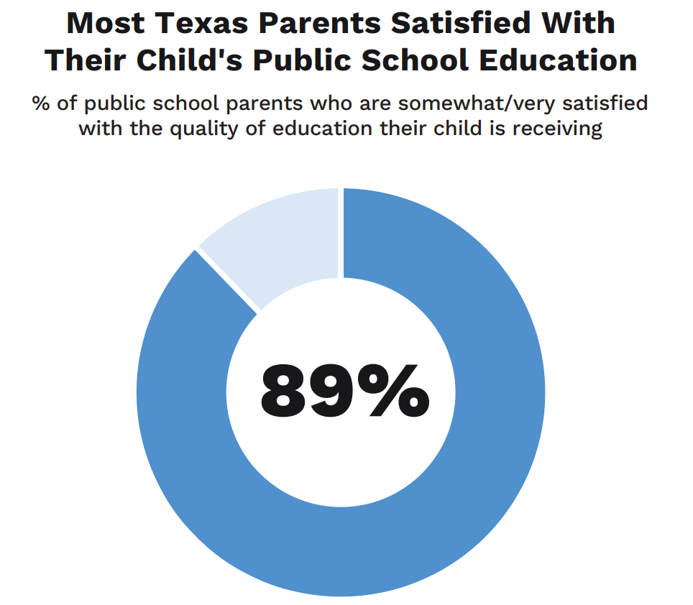
The Reality
Charles Butt Foundation 2023 Poll on Texans’ Attitudes Toward Public Education
Notes:
Jeff

Slide 47
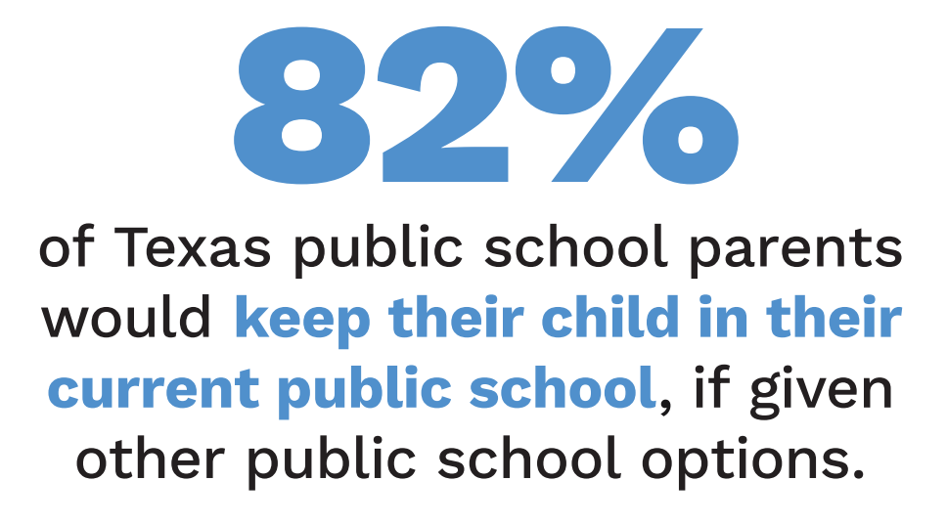
The Reality
Charles Butt Foundation 2023 Poll on Texans’ Attitudes Toward Public Education
Notes:
Jeff

Slide 48
We’re All in This Together
Whether you represent teachers or school districts, it is in everyone’s best interest to stop the bleeding of this teacher shortage
As discussed, there are local ways we can work together on this – assume good faith
But there are other ways to work on this as well – advocate for public education and vote
Notes:
Juan/Jeff

